Slide 1


BUFFER OVERFLOW
Presentation By: Taha Nasir Ifrah Noman Brooj Nasir Hoor-ul-ein
21-12-2023
Air University Islamabad
Cybersecurity.org

Slide 2

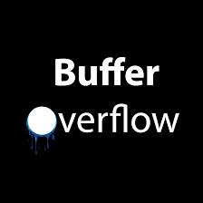
Introduction
1= Details of the vulnerability and how it arises.
2=Detailed exploitation of the vulnerability.
3=Details about the method/tools used to exploit the vulnerability.
4=How to patch the vulnerability.
Team:
Meteora

Slide 3
Exploitation
02
of the Vulnerability

Slide 4







A Step-by-Step Walkthrough
Building a Stack
Function Calls
Limited Space
Stack Overflow
s.
Changing The Order
Redirecting Execution
Executing Malicious Code

Slide 5
Exploitation Techniques:
Injecting Malicious Code
Altering Function Pointers
Manipulating The Stack
An attacker might overflow the stack with more data than it can handle. If this data includes carefully crafted instructions (malicious code), the program might execute those instructions.
Function pointers are like arrows pointing to tasks. By manipulating these pointers during a stack overflow, an attacker can make the computer jump to unexpected tasks.
Changing the order of tasks on the stack can lead to unexpected outcomes. An attacker can manipulate this to control the program's behavior.

Slide 6



Examples of Exploitation
Password Field
Web-Server Vulnerability
Imagine a login system where an attacker inputs a ridiculously long password. If the program doesn't check the input length, it might overflow the stack, allowing the attacker to alter the program's behavior and gain unauthorized access.
In web servers, input from users is a potential entry point. If an attacker sends data that overflows the stack, they might be able to inject code that manipulates the server's behavior, potentially leading to data breaches or service disruptions.
SQL Injection Attack
. An attacker can then inject SQL commands, altering the intended database queries and gaining unauthorized access to sensitive information.

Slide 7
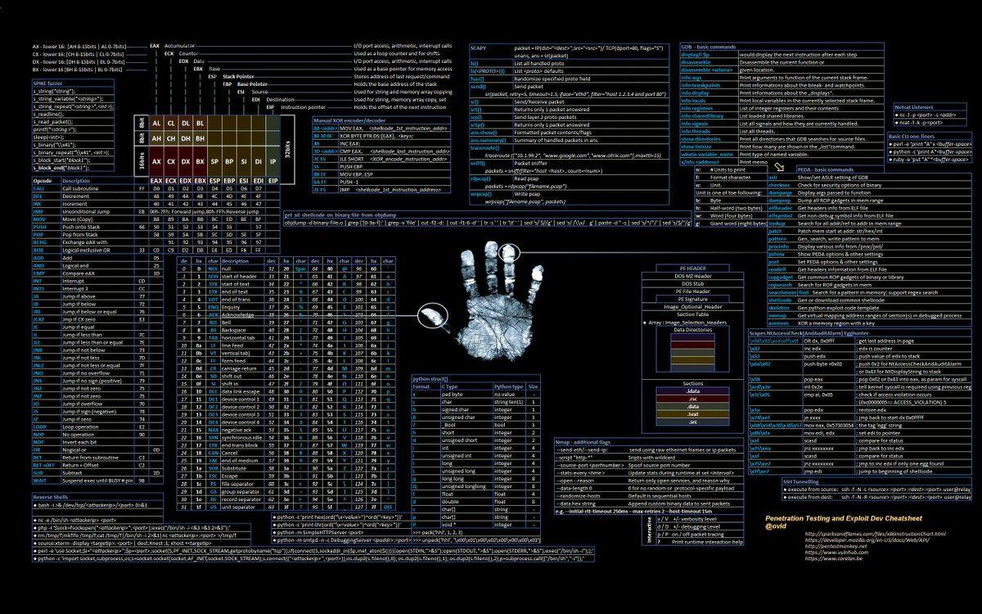
Demonstration
Demonstrating a stack based buffer overflow attack, by calling a function in a C program, which wasn’t explicitly called within the program.

Slide 8
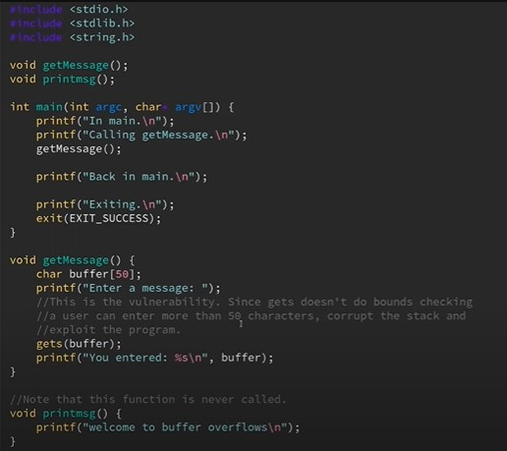
We write a basic script in C to help us perform the an example of the stack based buffer overflow.

Slide 9

If we run the code as normal, it looks something like this.
If we feed it a value, much larger than the buffer, we receive an error, segmentation fault. This error tells us that we have successfully overflowed the stack.

Slide 10
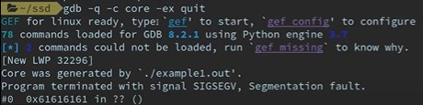
By running the ultima -a unlimited command, we can get a core file. A core file can be opened with the gdb debugger, to determine where the error occurred in the program and why.

Slide 11
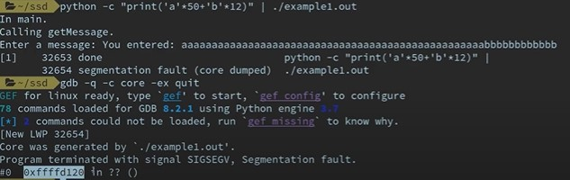
By doing a sort of binary search, we can find out when we reach the point in memory after overflowing, that we start overwriting the return address.

Slide 12
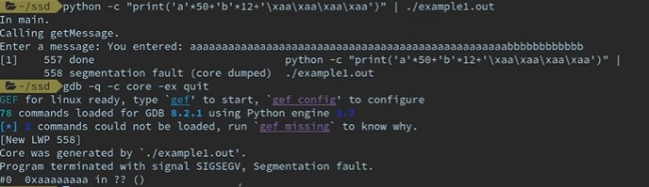
We can test this, by adding a random hexadecimal value at the end of our string, to see if it will overwrite the return address.

Slide 13

We find the memory address of the printmsg() function, by running the program in gbd, and using the “p printmsg” command within the debugger.

Slide 14
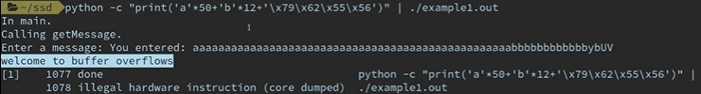
By adding the hexadecimal location bytes of the function at the end of our string, we can successfully inject the memory location of the printmsg() into the return address of the compiler and call the function, without it being called in the actual program itself.

Slide 15

Patch
vulnerability
How to Patch/Fix/Prevent vulnerability of bufferover flow

Slide 16


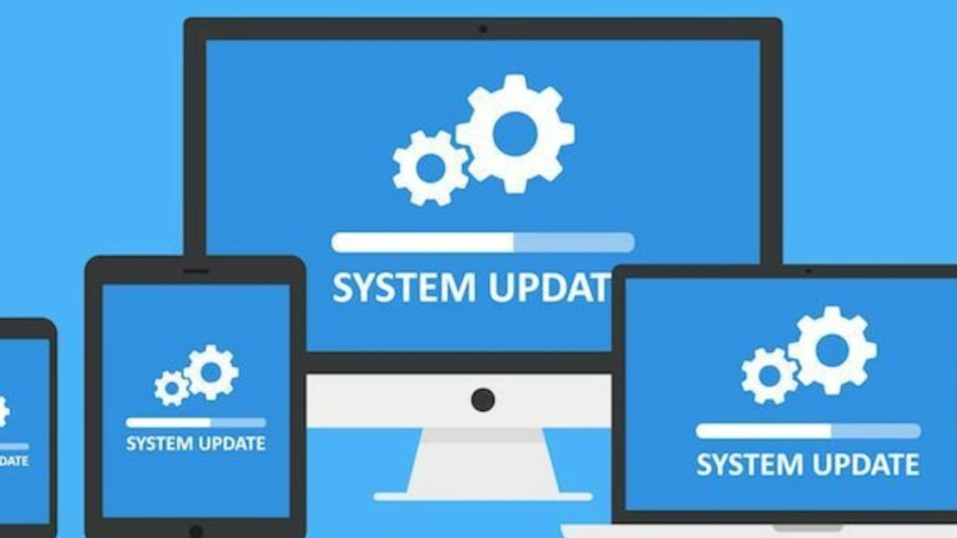


Common protection Methodologies.
Mitigate Buffer overflow attack.
Buffer overflow Solutions.
websites and tools to protect against Buffer overflow attack.
Conclusion.

Slide 17

Developers can protect against buffer overflow vulnerabilities via security measures in their code, or by using languages that offer built-in protection.
In addition, modern operating systems have runtime protection.
Three common protections are:

Slide 18
Common Protections Methodologies:
ASRL
DEP
(SEHOP).
Address space randomization
Data execution prevention
Structured exception handler overwrite protection

Slide 19



Mitigate Buffer overflow Attack:
.
Bot Management
web Application Firewall
DEP
Account Takeover Protection

Slide 20
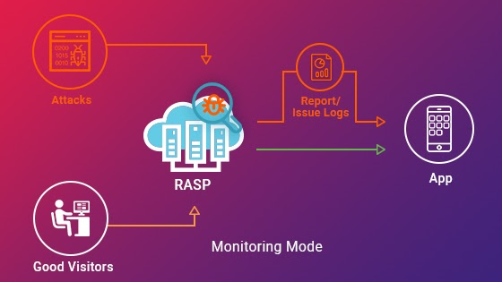
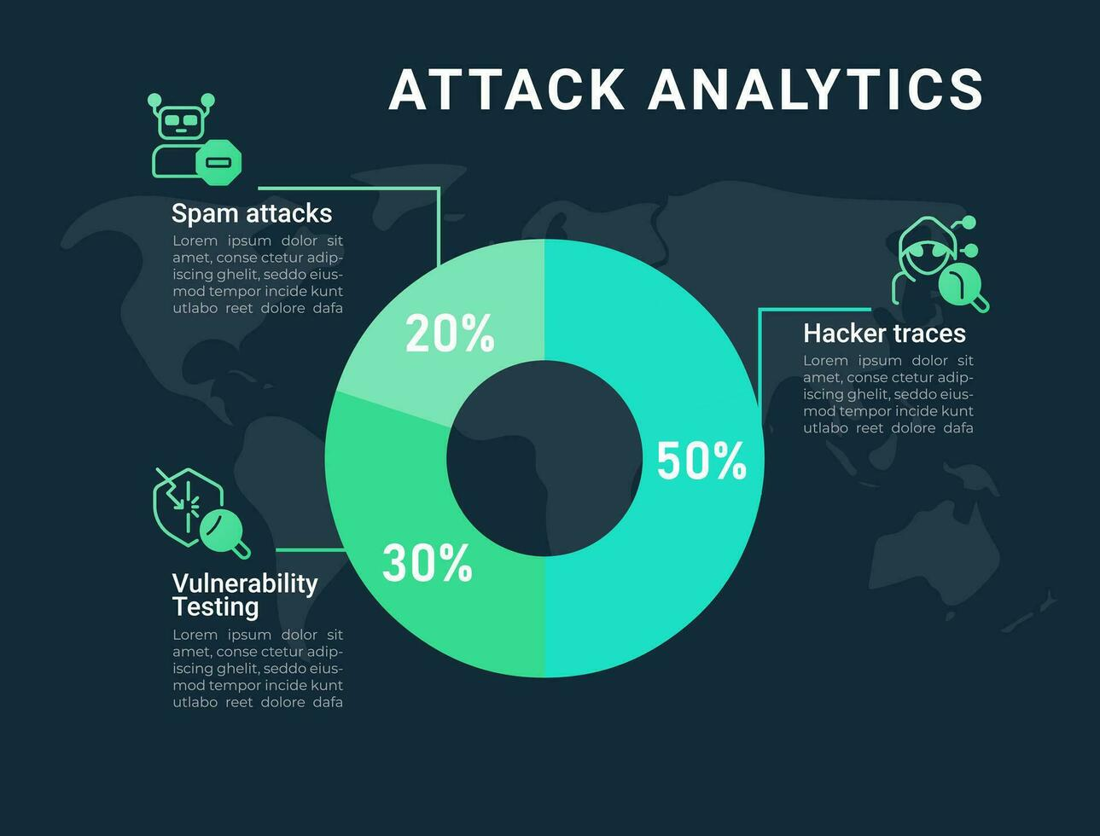

Mitigate Buffer overflow Attack:
API Security
RASP
Attack Analytic

Slide 21
Buffer Overflow Solutions!!

Slide 22
standard library functions
use automatic protection at the language level.
secure development practices.
bounds-checking enforced at run-time.

Slide 23
Websites and Tools protecting against Buffer overflow attack
OWASP (Open Web Application Security Project):
CERT (Computer Emergency Response Team) - Secure Coding Standards:
TOOLS:
AddressSanitize
GCC Stack Protector
Microsoft Buffer Security check (/GS):
Clang Static Analyzer
Binary Analysis Tool-IDA pro
Valgrind

Slide 24
Conclusion

Slide 25

ANY QUESTION?????

